Slide 1


Department of Education Sciences in Early Childhood
Democritus University of Thrace
School of Education Sciences

Slide 2
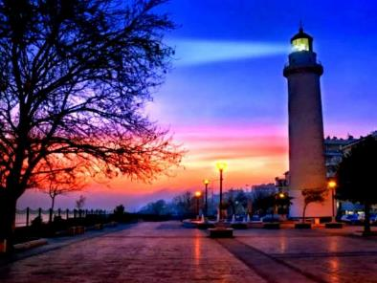
The Department of Education Sciences in Early Childhood is in Alexandroupolis, the prefecture of EVROS in Greece
"The crossroads of peoples, cultures and natural beauty!"

Slide 3
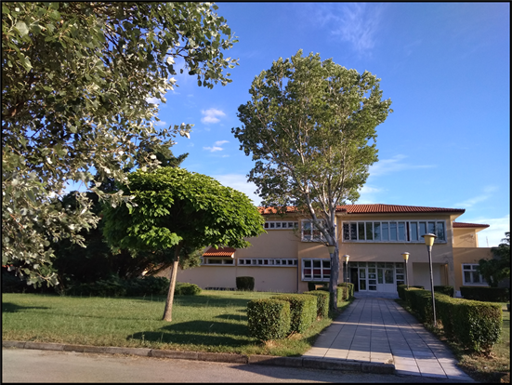
Of the 20 departments of the Democritus University of Thrace, four are located in Alexandroupolis
The Department of Medicine
The Department of Molecular Biology and Genetics
The Department of Primary Education
Department of Education Sciences in Early Childhood
4,500 Students

Slide 4
Graduates of the Department of Education Sciences in Early Childhood may find occupation:
In educational settings
1
In the private and public sector as educators or education administrators
In the wider private and public sector
2
Museums, Hospitals, Social Structures, Educational Material and Software Creation Companies, etc.
Academic and Research career
3
In universities and educational centers in Greece and abroad

Slide 5
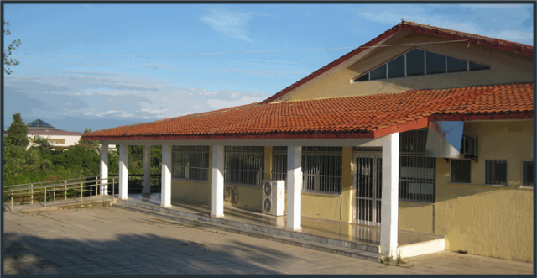
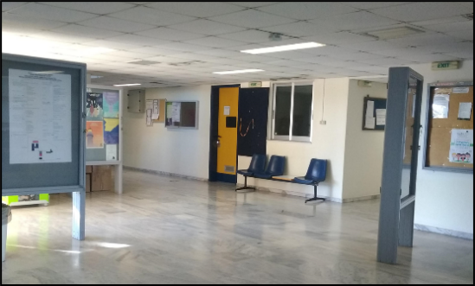
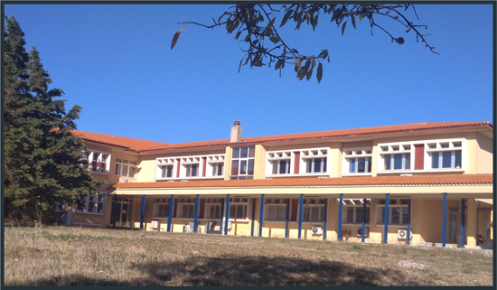
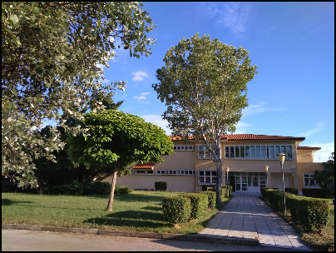
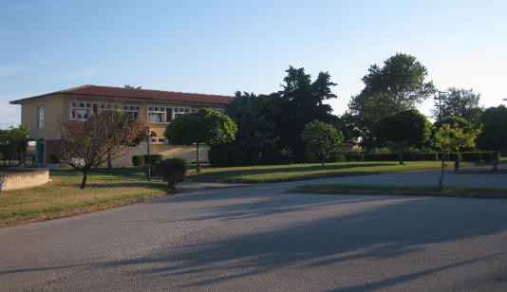
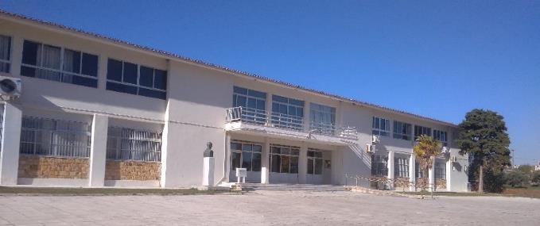
Facilities of the Faculty of Education Sciences - DUTH
Wifi connection in all the areas of the campus.

Slide 6
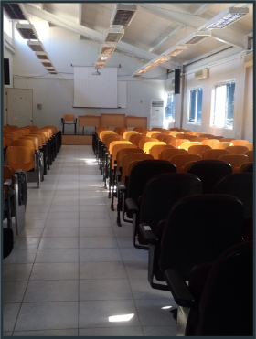
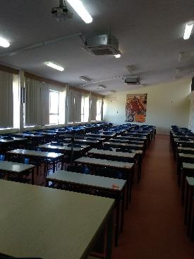
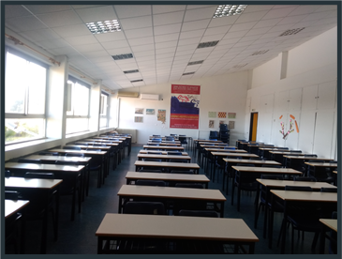
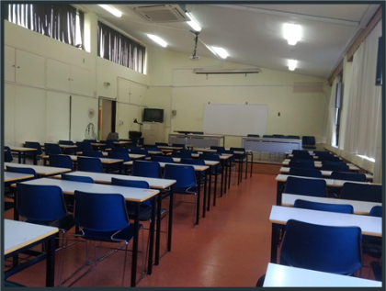
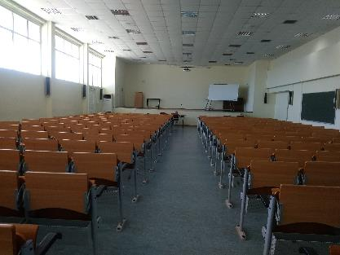
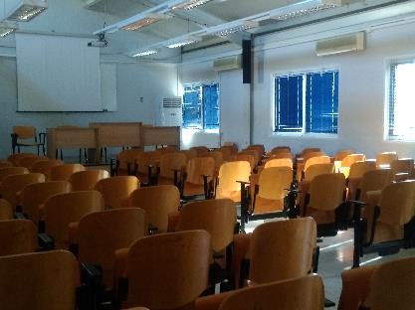
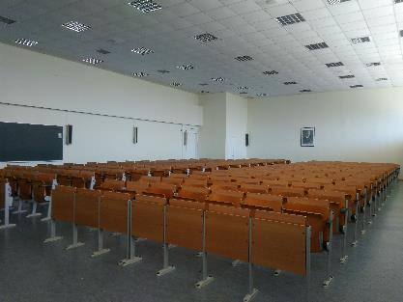
Lecture Halls

Slide 7
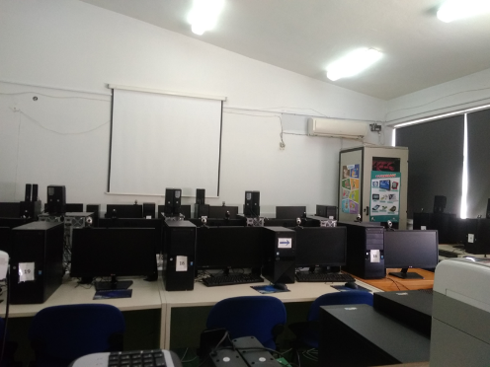
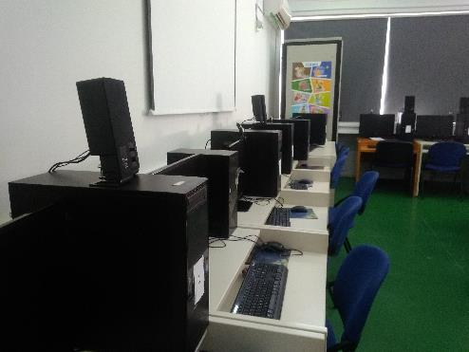
Laboratories
Laboratory of Informatics
Main goals of the Laboratory :
Support of teaching in the Department in aspects involving Informatics
Enhancement of the role of the early childhood educator with the exploitation of ICT
Basic and applied research in Informatics and in aspects concerning the integration of ICT in education

Slide 8
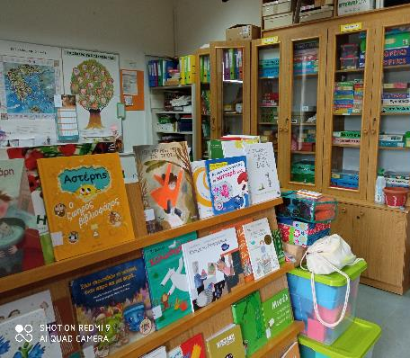
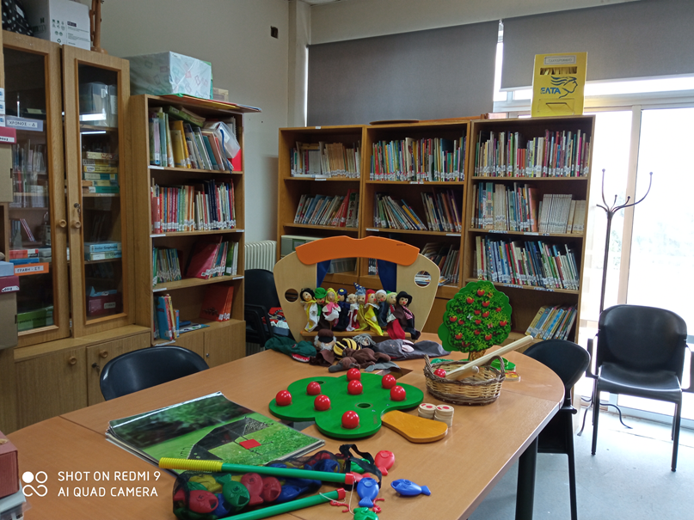
Laboratories
Office of Educational Material – Special Library
2000 Books and Journals,
600 Educational Toys
Educational robots (Bee-bot, Mouse)
Educational material STEAM
Educational museum packages

Slide 9

Laboratories
Laboratory of Pedagogical Research and Educational Practice contributes to the reflection and
action of future teachers in matters related to the educational practice by proposing
research,
educational activities

Slide 10
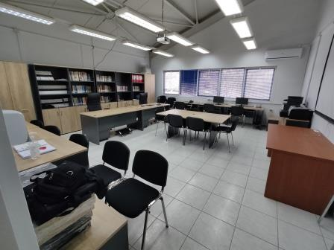
Laboratories
Laboratory of Child Psychology
serves the educational and research needs in the fields such as
Child Psychology
Child Psychopathology
Educational Psychology
and the support of the pedagogical work carried out in local kindergartens.

Slide 11
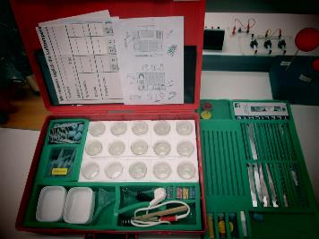
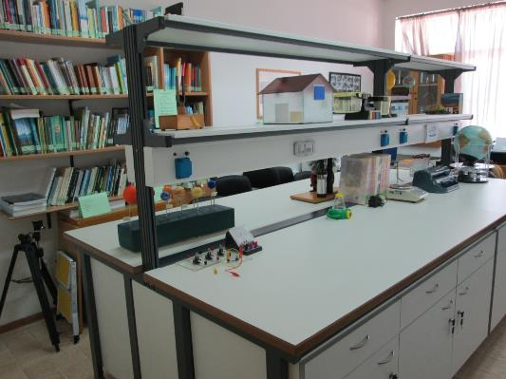
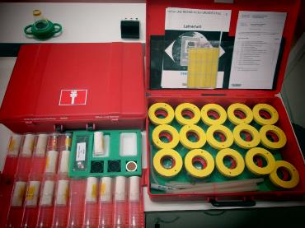
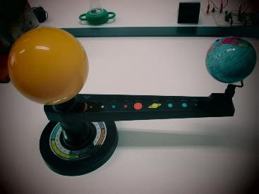
Laboratories
Laboratory of Environmental Research and Communication and Environmental Education
Γραφομηχανή Βraille

Slide 12
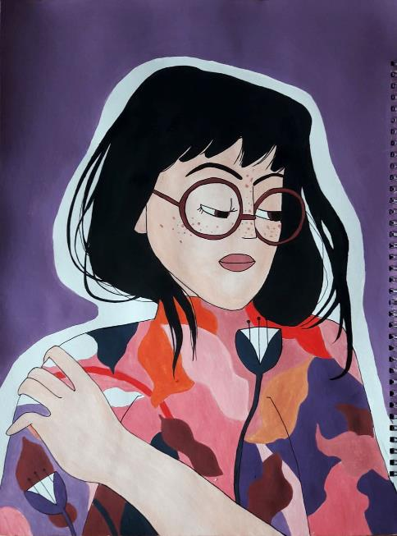

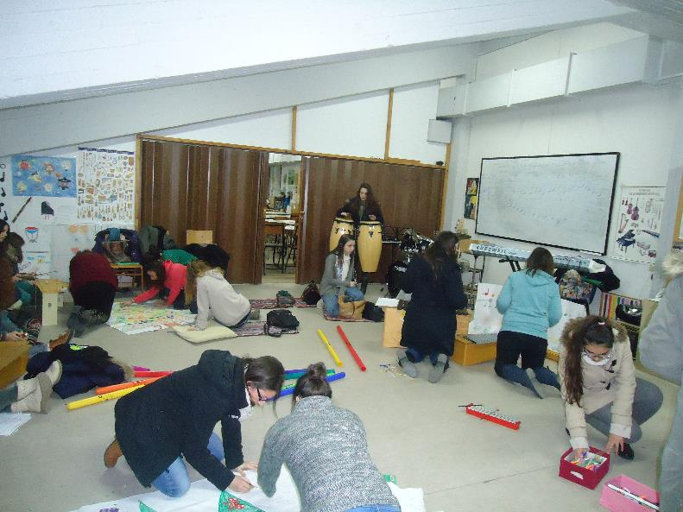
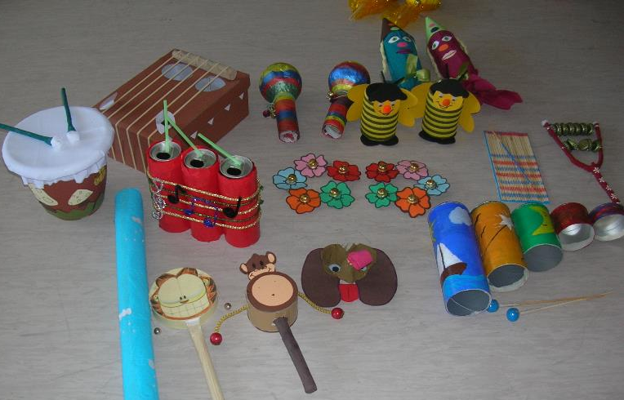
Laboratories
Laboratory of Arts and Crafts of Educational Materials (in collaboration with the Department of Primary Education)

Slide 13
Presentation of Analytical Programme of Studies

Slide 14
Analytical Programme of Studies Course Groups
01
02
03
04
Philosophical, Sociological and Historical Approaches to Education
Culture and Education
Pedagogics - Didactics
Psychology
05
06
07
Sciences
Educational Research Methodology
Foreign Languages

Slide 15
Philosophy of Education
Introduction to Philosophy
Religion and Education in Multicultural Societies
Visual Literacy
Texts of Philosophical – Pedagogical Reflection
Philosophical, Sociological and Historical Approaches to Education
History of Childhood
Anthropological Approaches to Reading
Anthropological Approaches of Kinship and Family
School-Community Relations
History of Modern Greek Education (1830-)
Intercultural Education

Slide 16

Sexuality and Health
Communication and Language Development
Cognitive Psychology
Educational Psychology
Evaluation and Support of Children with Special Educational Needs
Psychology
Social Psychology
Intergroup Relations in Social Psychology
Psychopathology of the Child
Psychology of Child Development
Child and Life Events
Health Psychology
Experimental Psychology: Theoretical and Methodological Approaches

Slide 17

Introduction to Museum Education
The Child and the Literary Book
Dramatic Play – Dramatization
Introduction to Modern Greek Literature
Illustrated Children’s Books and their Reading
Drama in Education
Culture and Education
Creative Writing
Narrative techniques – Approaches to the Oral Speech
Contemporary Greek Literature for Children
Introduction to Children’s Literature
20th Century Poetry
Creative Music Activities for Kindergarten
Monolingual/Bilingual Pragmatic Ability

Slide 18

Bilingualism and Education
Development of Pedagogical Thinking
Contemporary Didactics: Basic Notions and Application Proposals
Pedagogy and Play in Early Childhood Education
Evaluation: Theoretical Approaches and Applications in Early Childhood Education
Greek Language Teaching
Pedagogics - Didactics
Introduction to the Sciences of Education
Collaborative Types of Learning in Early Childhood Education
Current Educational Directions
Special Education
Social Pedagogy
Health Education in Early Childhood
Emergent Reading and Writing: Teaching Approaches for Preschool and Early School Age

Slide 19

Descriptive Statistics
Principles of Informatics with Applications in Education
Informatics in Education
Sciences
Teaching and Learning of Science for Early Childhood
Multimedia and Networks in Early Childhood Education
Basic Concepts of Mathematics
Mathematics in Early Childhood Education
Environmental Education, Sustainability and Sustainable Development
Geometrical Concepts

Slide 20


for Specific Purposes
Methodology
Foreign Languages
Educational Research Methodology
English
και
French
Research Writing in the Social Sciences and the Humanities

Slide 21
Vocational Training
Practicum begins from the 1st year of studies
In Kindergartens, Hospitals, Museums and other educational settings
Aesthetic Education
The Project Method in the Kindergarten
Tutorial on Hazards and Accidents
Creative Music Activities for Kindergarten
Puppet Theatre for Children
Organization and Administration of the Educational Unit
Handling Cultural Diversity in the Classroom
Observation of the Child

Slide 22
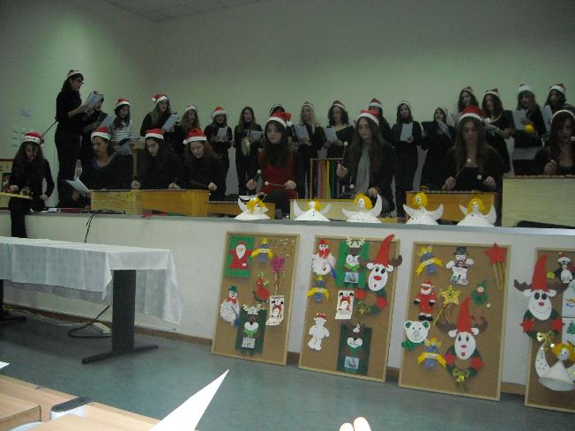

Educational and Training Activities in the Department
Crafting Musical Instruments and
Musical Performances

Slide 23
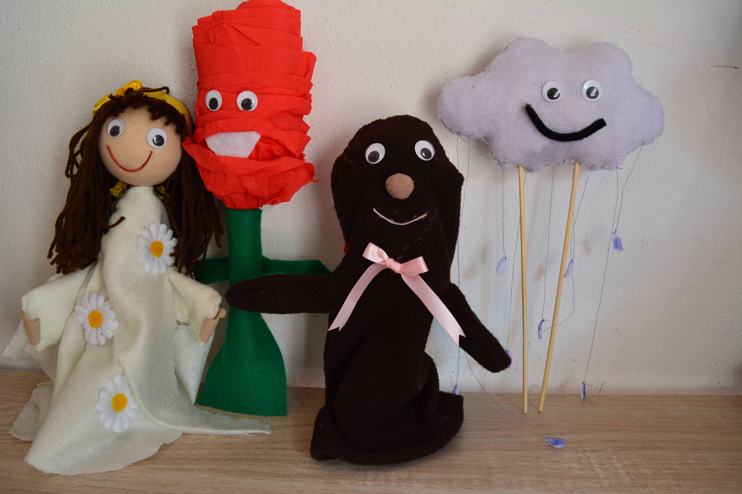
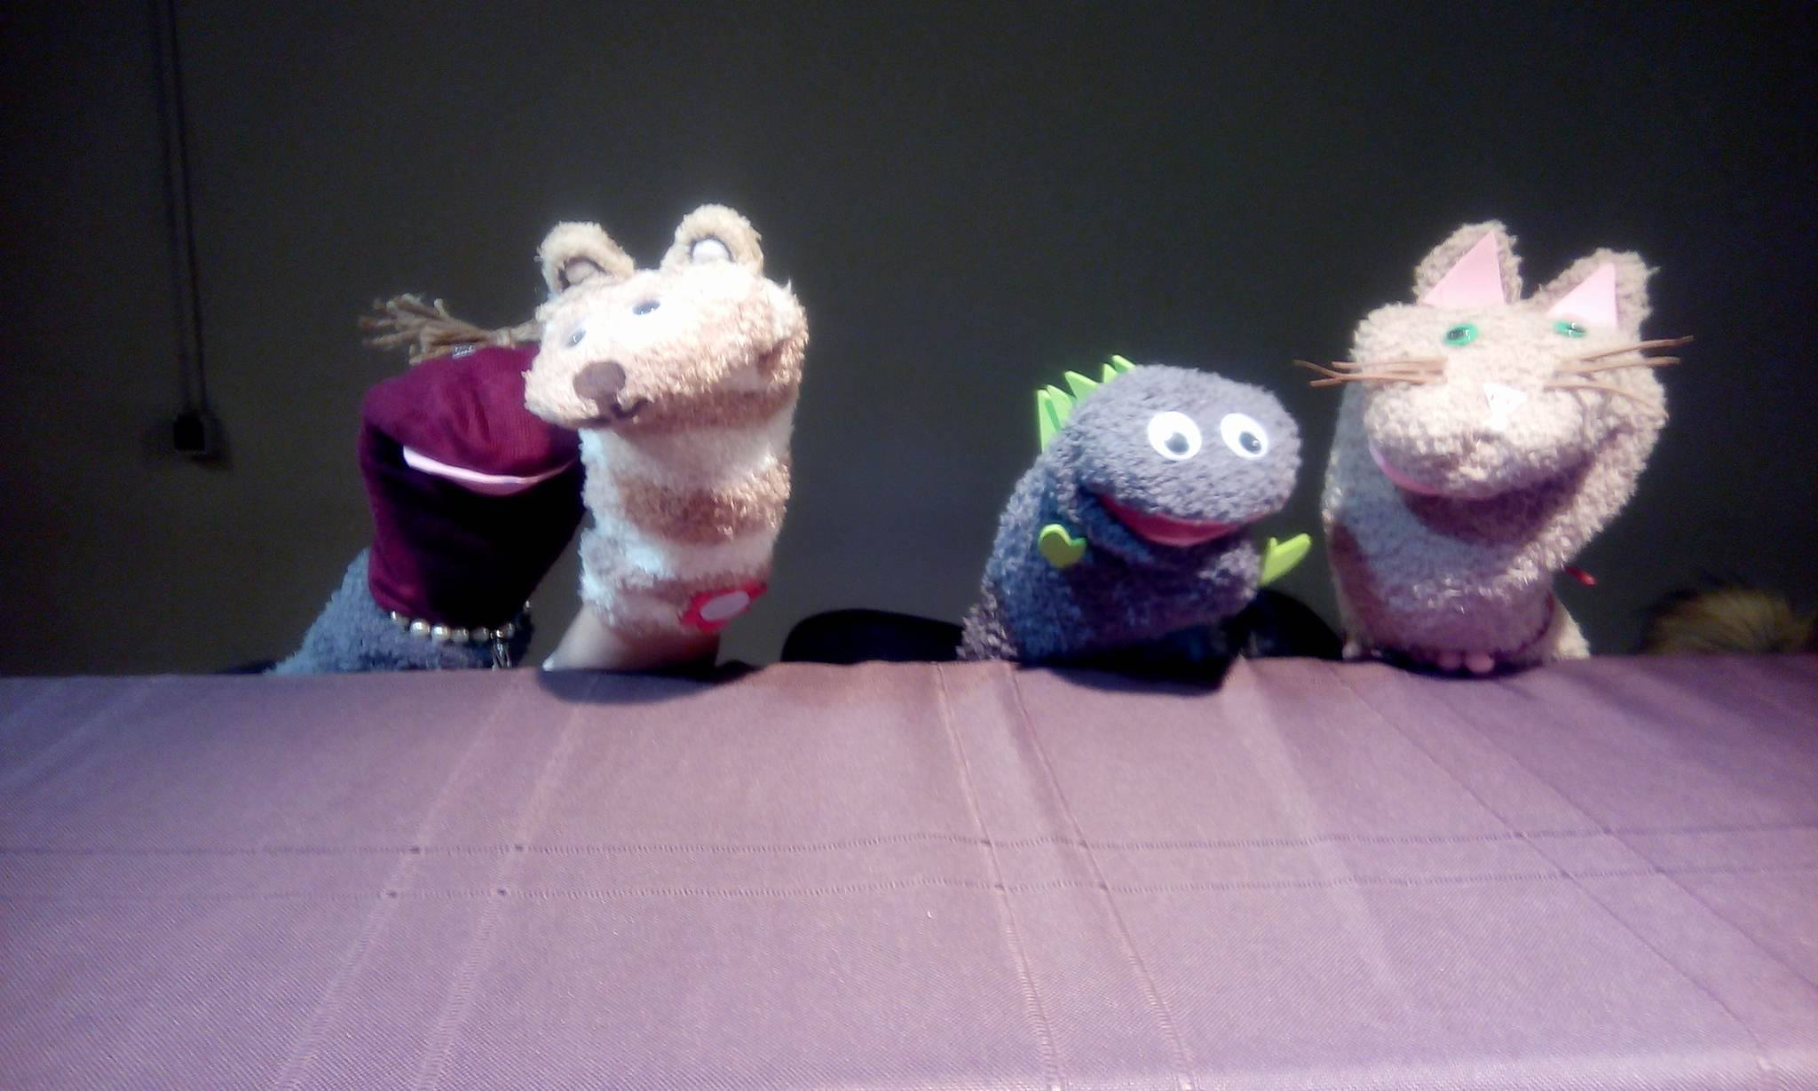
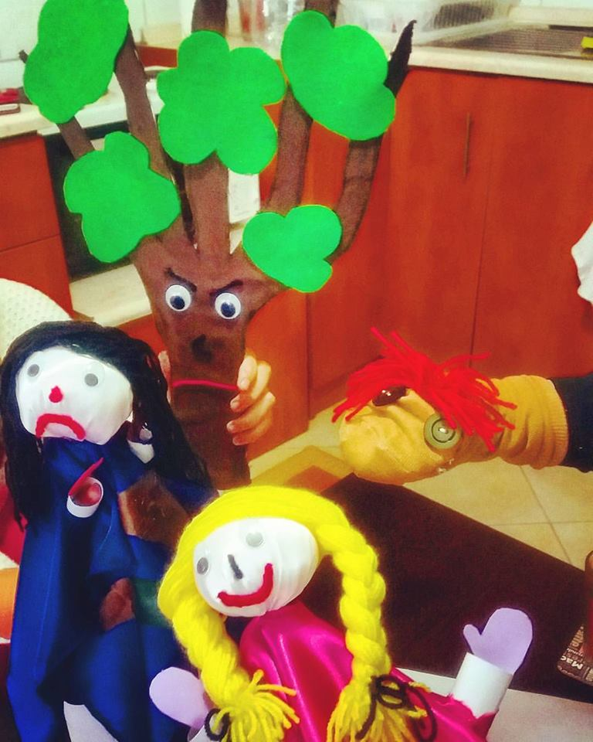
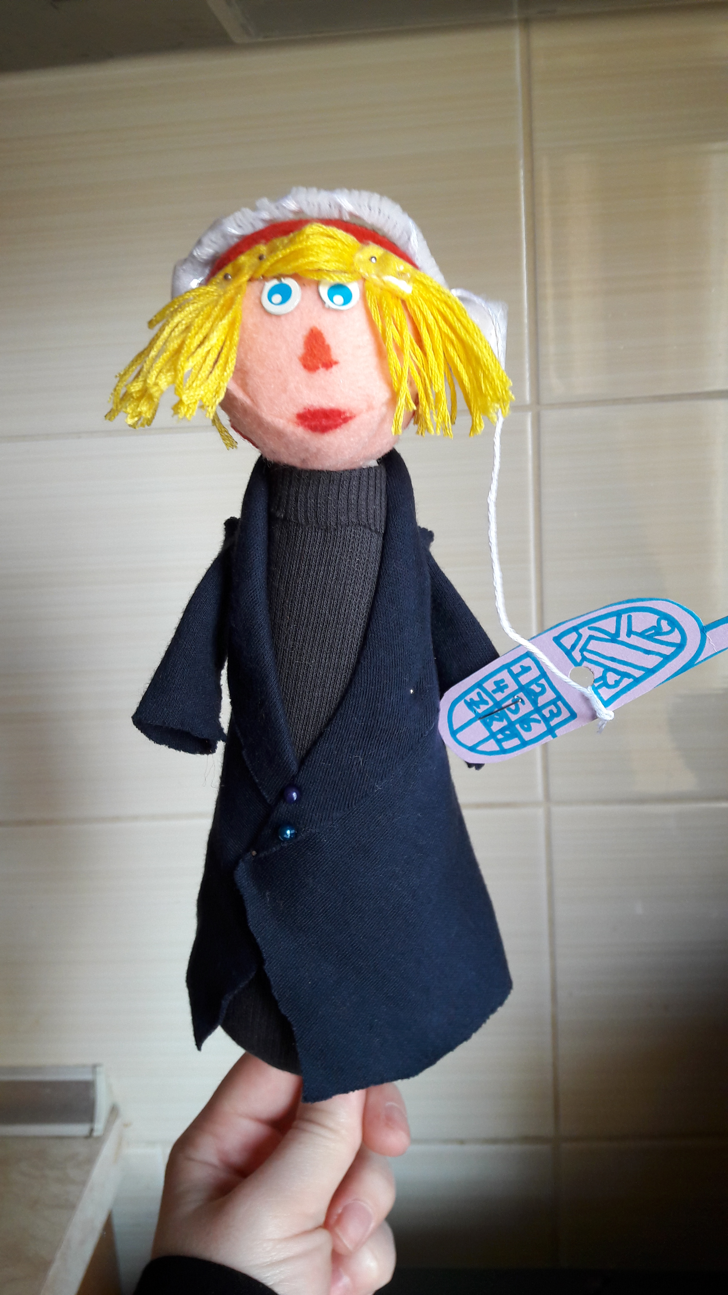
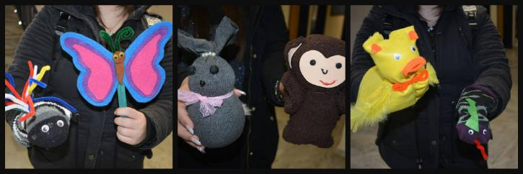
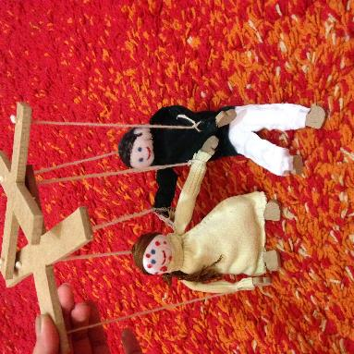
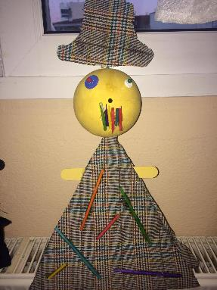
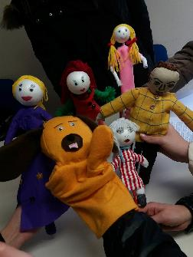
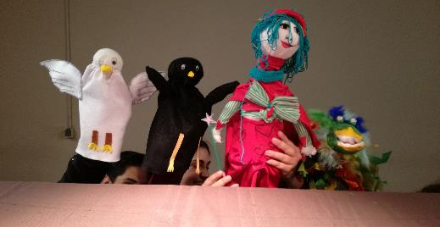
Educational and Training Activities in the Department
Making puppets and puppet shows

Slide 24
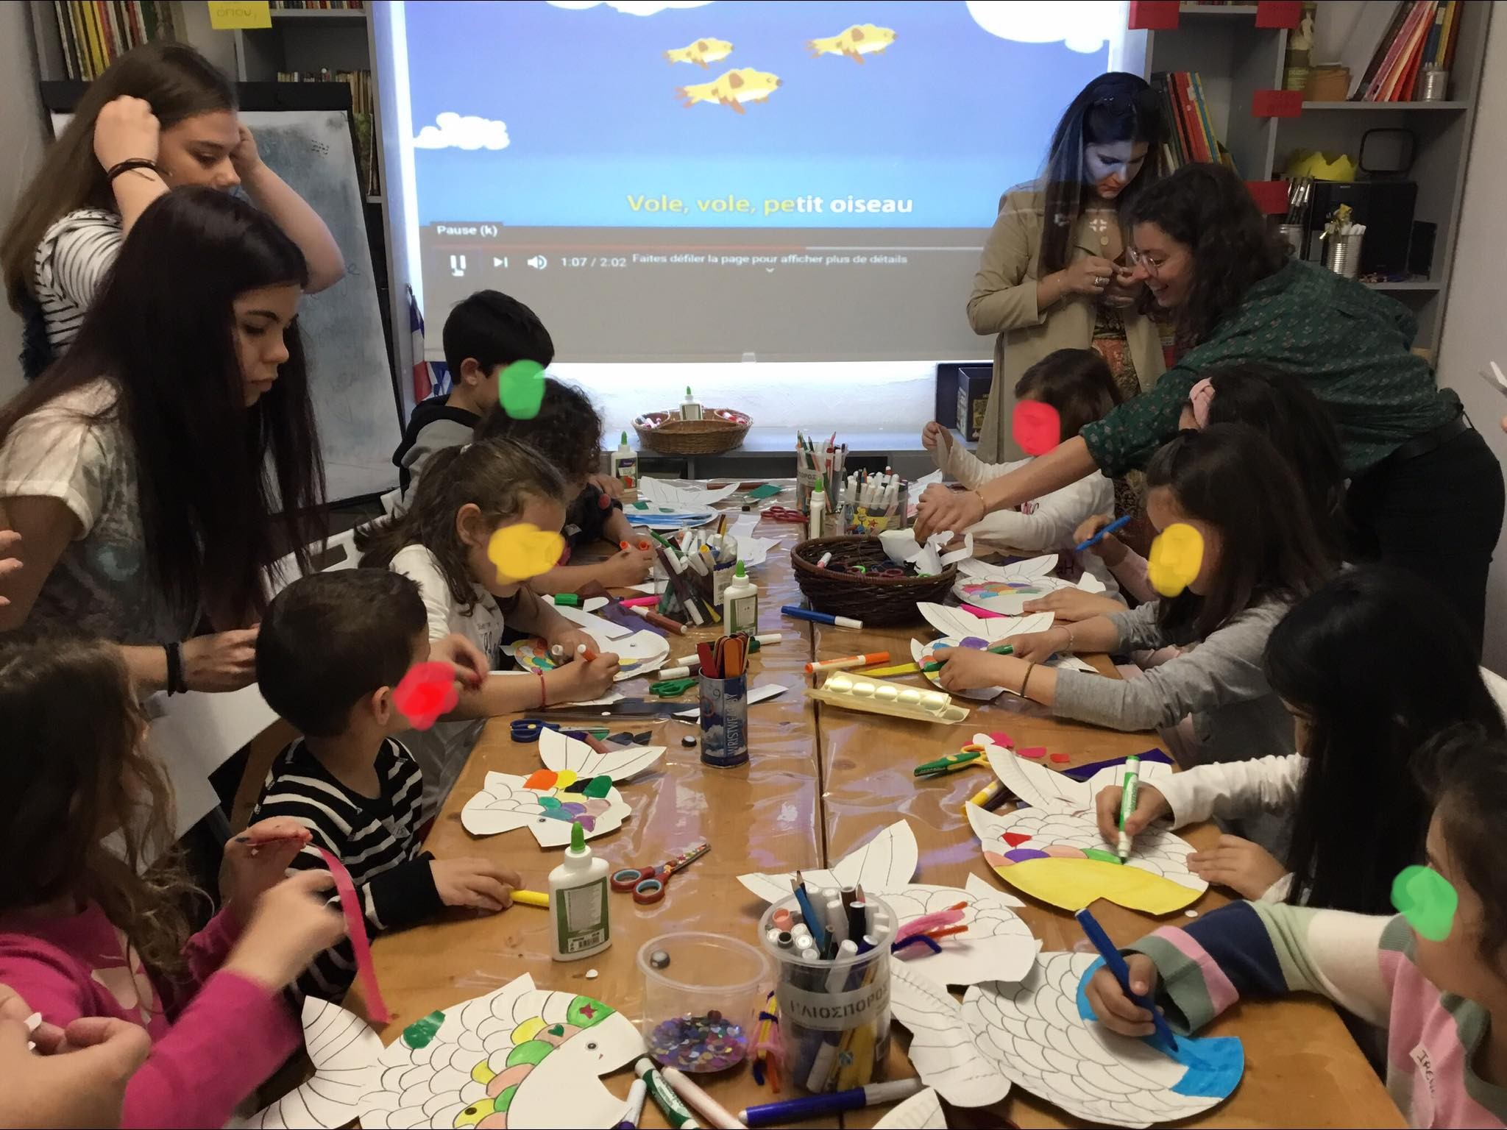
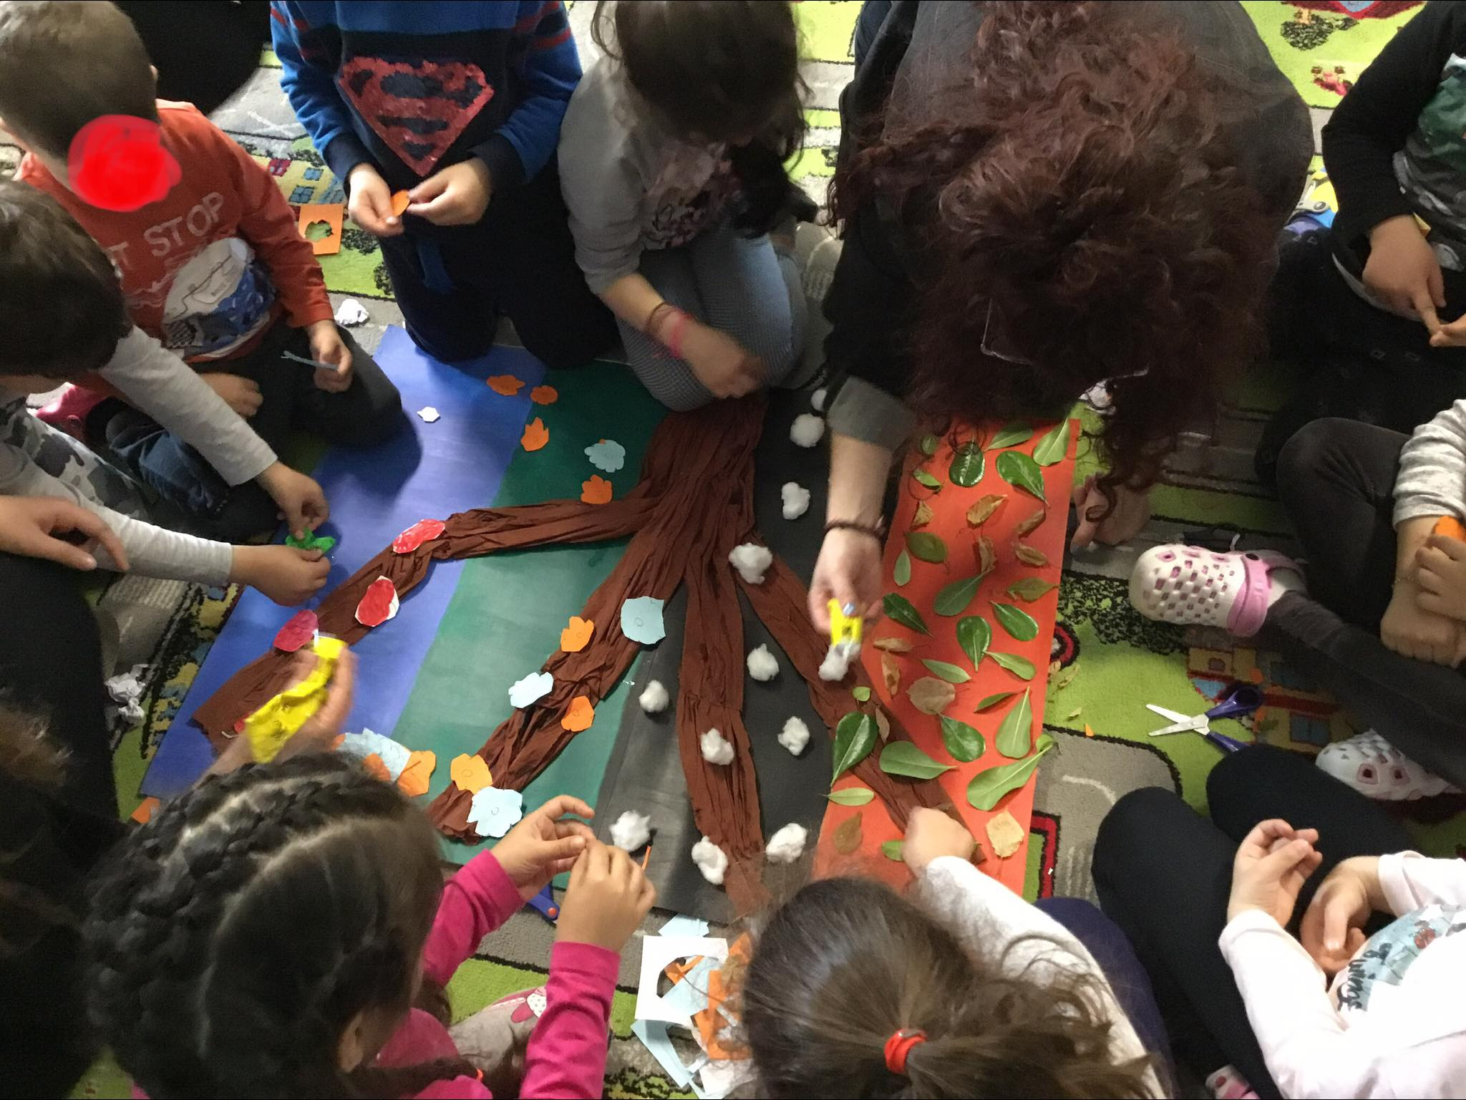
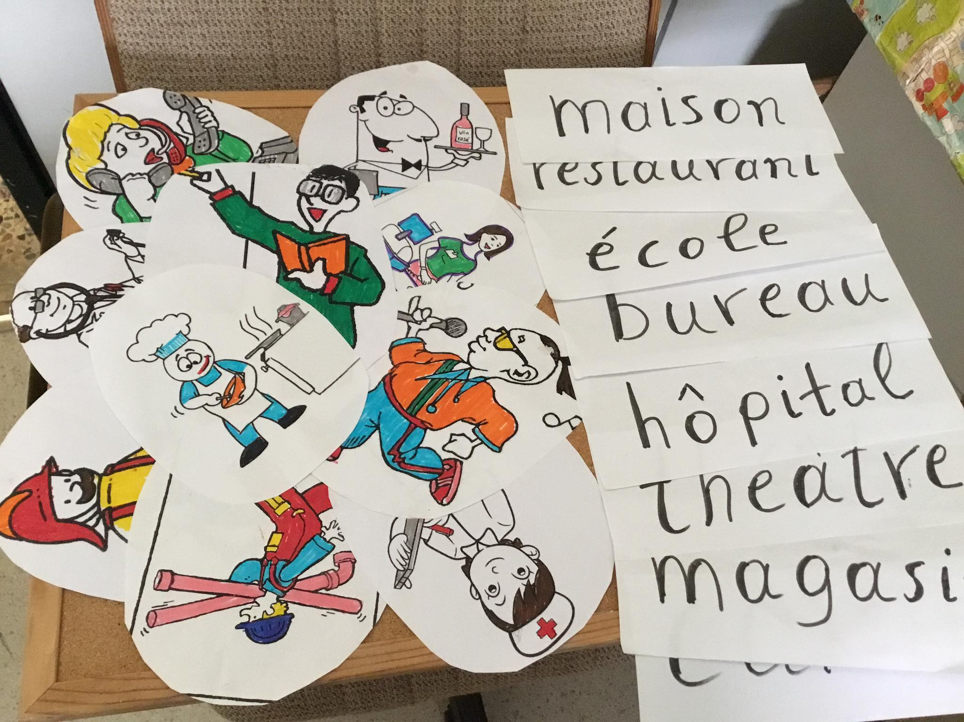
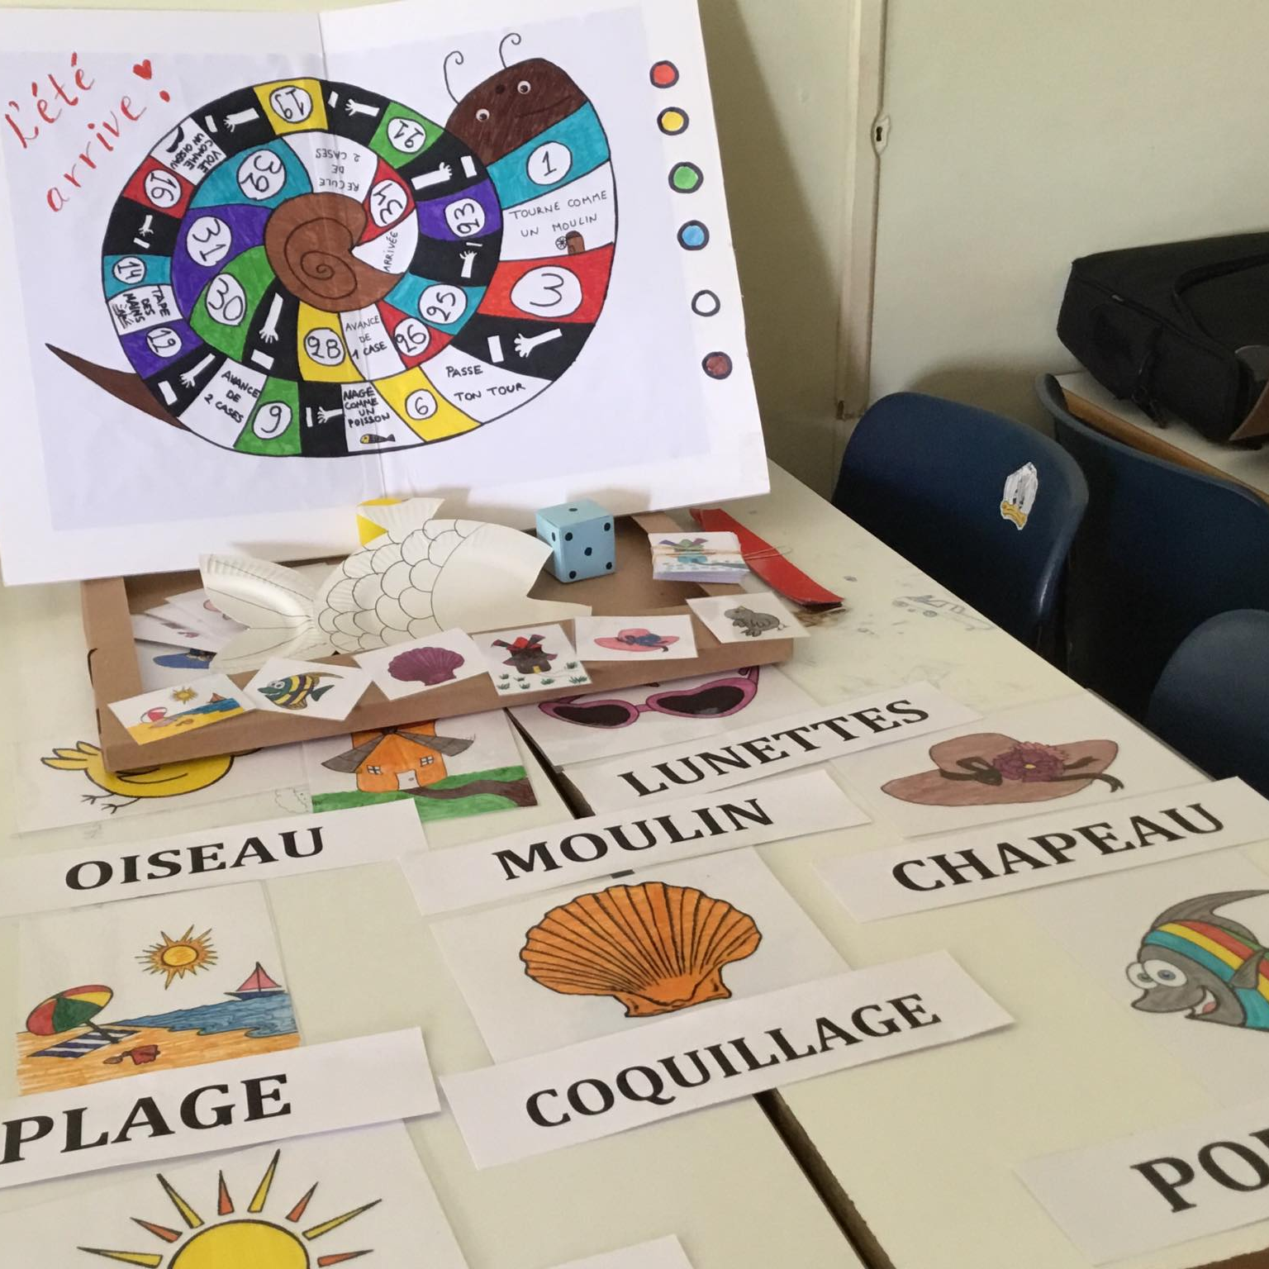
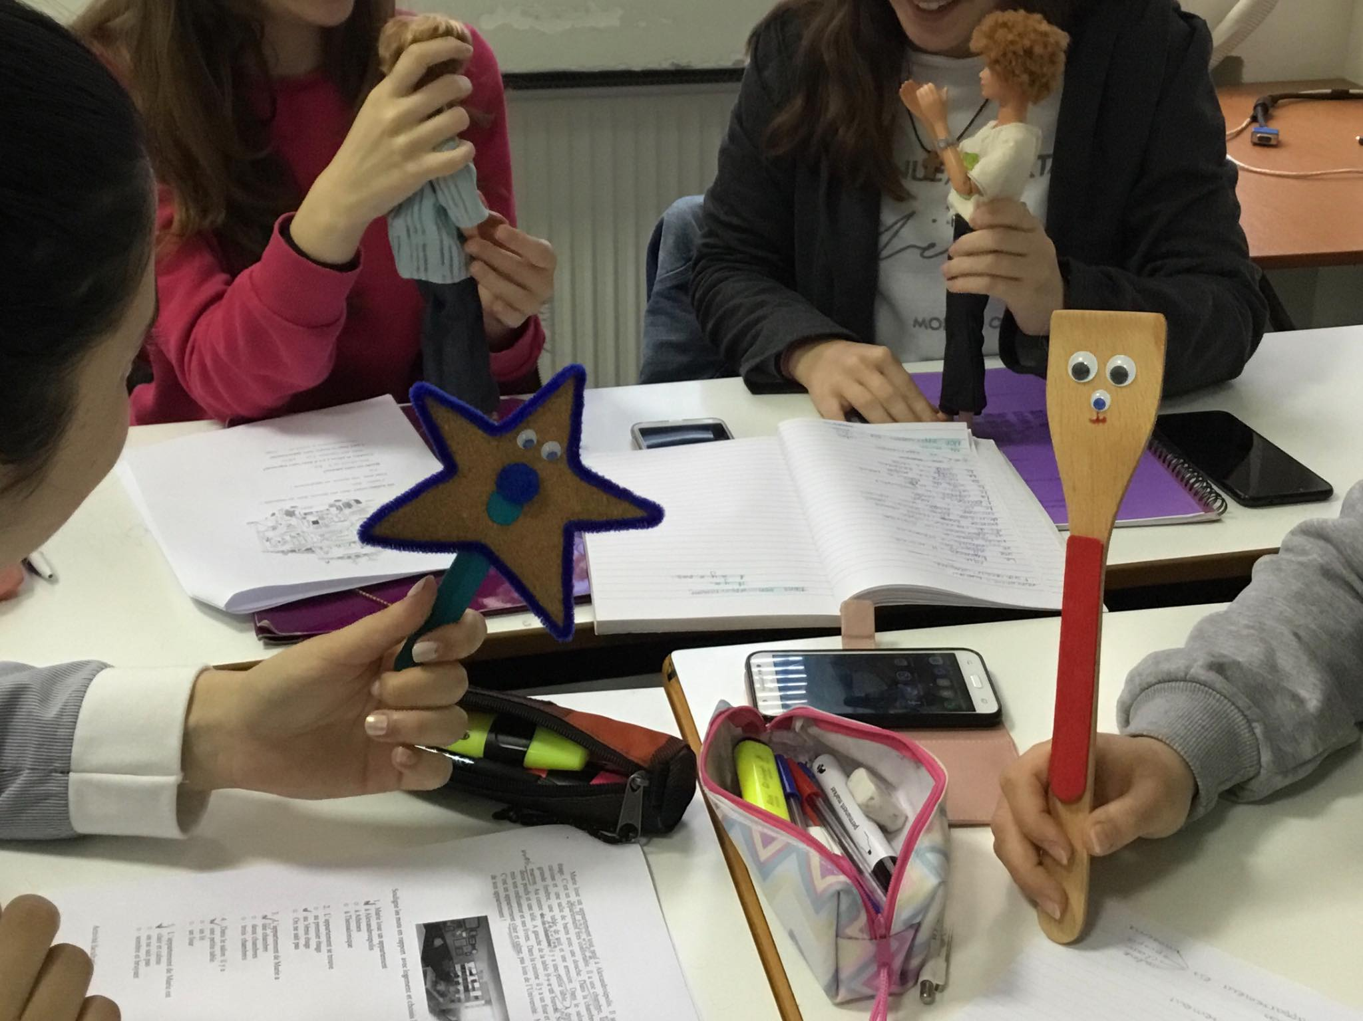
Educational and Training Activities in the Department
Laboratory of Foreign Languages

Slide 25
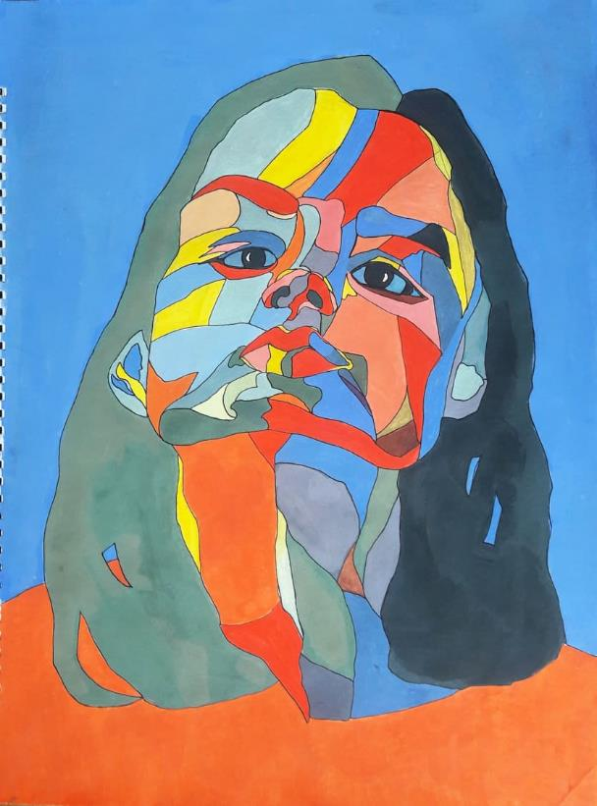
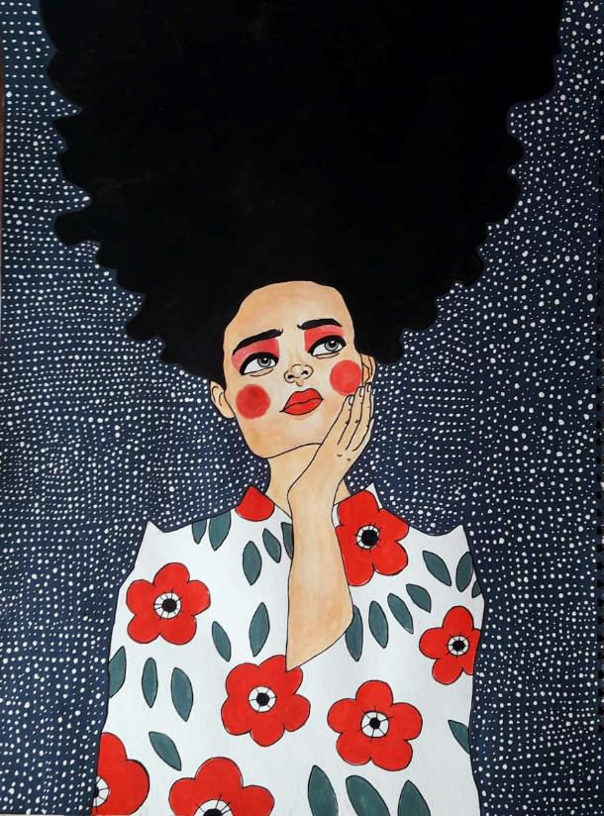
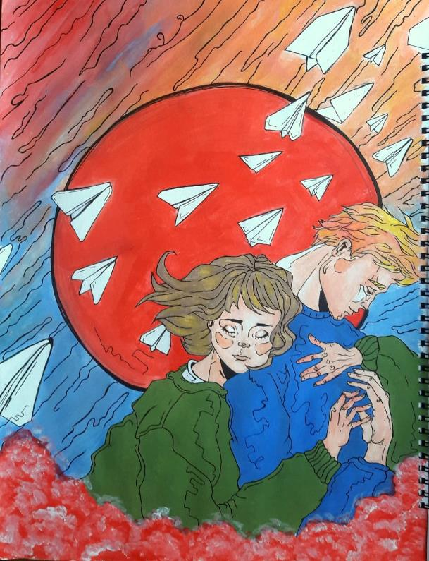
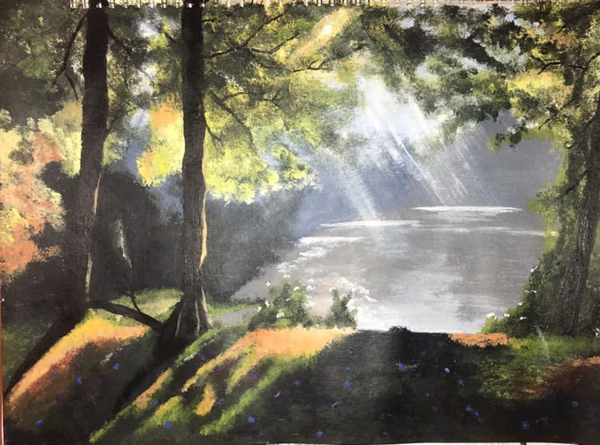


Educational and Training Activities in the Department
Student’s Art Projects

Slide 26
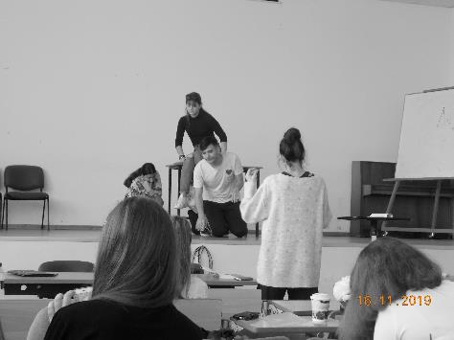
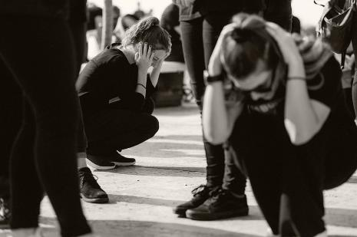
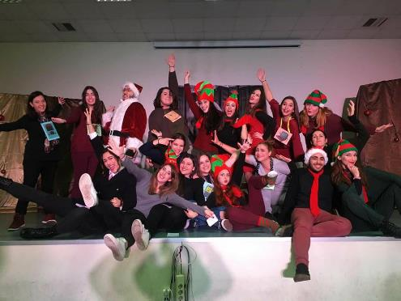
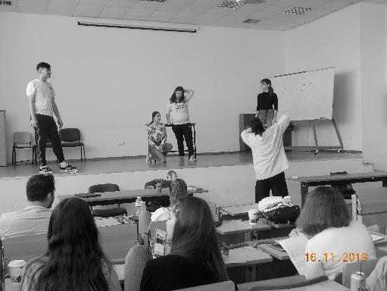









Educational and Training Activities in the Department
Theatre Group

Slide 27


Since 1996, the Democritus University of Thrace has actively participated in the mobility program Erasmus, acting as a reception and origin agency for hundreds of incoming and outgoing students and teachers.
The Department has bilateral agreements with the following Universities:

Slide 28












The Department has bilateral agreements with the following Universities:
Spain:
Universidad de Burgos
Universidad de Córdoba
France:
Université de Strasbourg
Institut National des Langues et Civilisations Orientales (INALCO)
Bulgary:
Sofia University St. Kliment Ohridski
University of Veliko Turnovo St. Cyril and St. Methodius
Norway:
Oslo and Akershus University College of Applied Sciences
Germany:
Karlsruhe University of Education

Slide 29


For further information visit our site: www.psed.duth.gr

Slide 30
Democritus University of Thrace
School of Education Sciences
Department of Education Sciences in Early Childhood
Music: https://www.bensound.com
Maria Chatzisavvas DESEC, DUTh.

